Slide 1
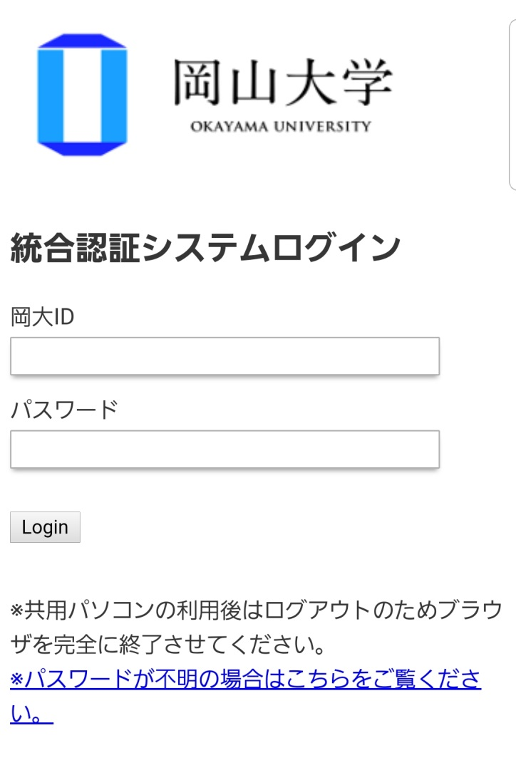
How to make a reservation of the Health Check-up.
①Visit the website of the Health Check-up Reservation System.
Click here : URL：https://kenshin.hokekan.okayama-u.ac.jp/
②Please sign-in.
Enter your OKADAI ID and password.
Caution!!
Please make a reservation by 35min before the check-up.

Slide 2
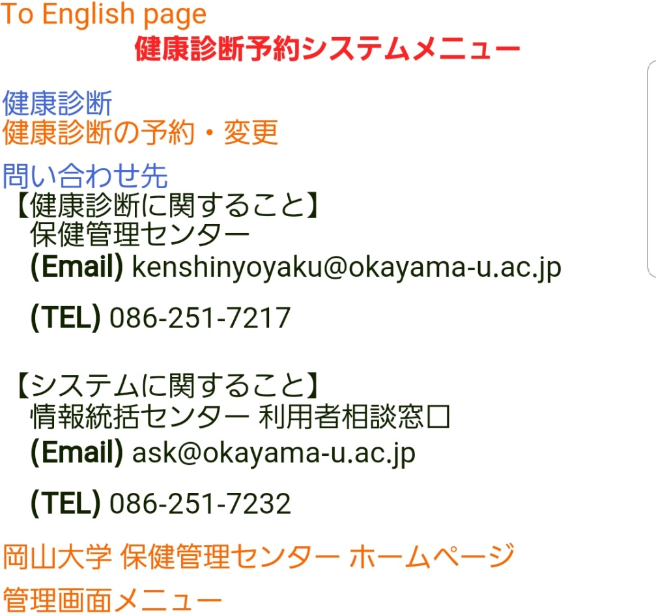
③Click the “To English page” button.
Click here.
Click here.
※If you take a health check-up at another clinic, please submit a copy of health check-up results to us.

Slide 3
④Click an appropriate “Reservation” button.
Choose an appropriate health check-up, and click the corresponding “Reservation” button.
Click here.
It will be displayed on the screen “Tsushima Campus”

Slide 4
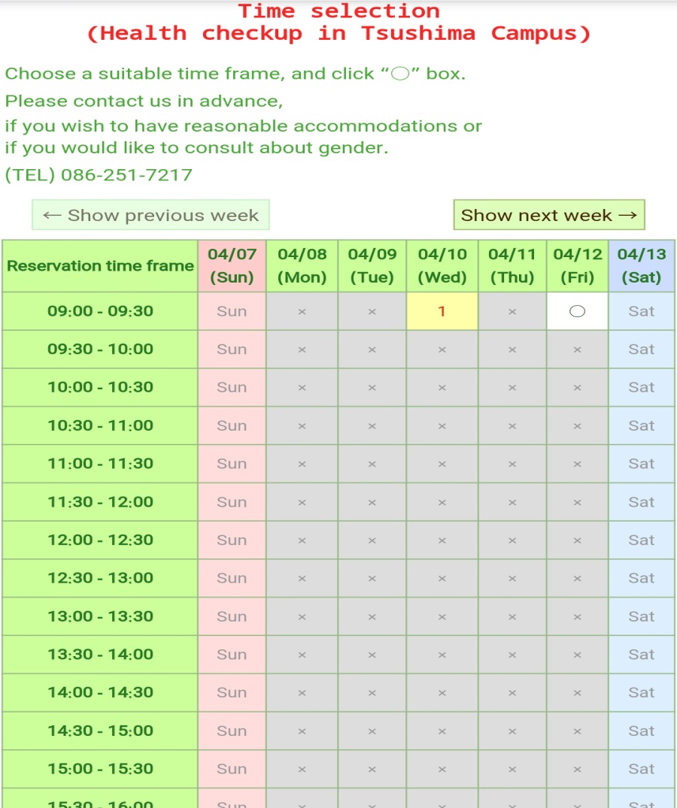
⑤Choose a suitable time frame,
and click the “○” box.
⑥Confirm the reservation details,
and click the button.
If there is no problem with the reservation details, click the button to confirm the reservation.
Don’t forget to take a health check-up.

Slide 5
How to change or cancel your reservation of the Health Check-up
① Visit the website of the Health Check-up Reservation System.
URL：https://kenshin.hokekan.okayama-u.ac.jp/
②Please sign-in.
Enter your OKADAI ID and password.
Caution!!
You can change the reservation by 35min before the check-up!!

Slide 6
③Click the “To English page” button.
Click here.
Click here.
※If you take a health check-up at another clinic, please submit a copy of health check-up results to us.

Slide 7
④You can see your reservation details.
Click the “Cancel” button, if you need to cancel the reservation.
⑤Confirm the cancellation details, and click the “Confirm” button.
Click here.
Click here.
Click the “Change” button, if you need to change the reservation.
Then, choose a new suitable time frame again.

Slide 8
If you take a health check-up at another clinic,
please register that on the Health Check-up Reservation System.
① Visit the website of the Health Check-up Reservation System.
URL：https://kenshin.hokekan.okayama-u.ac.jp/
②Please sign-in.
Enter your OKADAI ID and password.

Slide 9
③Click the “To English page” button.
Click here.
Click here.
※If you take a health check-up at another clinic, please submit a copy of health check-up results to us.

Slide 10
④Click an appropriate “Register” button.
※Moreover, you need to
submit a copy of health
check-up results to us.
Click here.
⑤Check the details, fill in comments if any, and click the “Confirm” button.
Click here.

