Slide 1
Method of Questionnaire for medical check-up

Slide 2
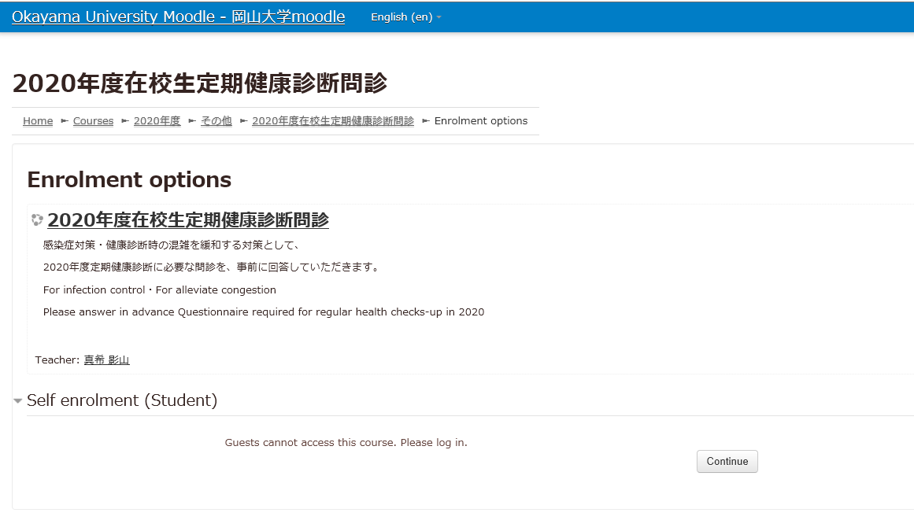
English or Japanese
click
Please click Continue and login with Okadai ID.

Slide 3
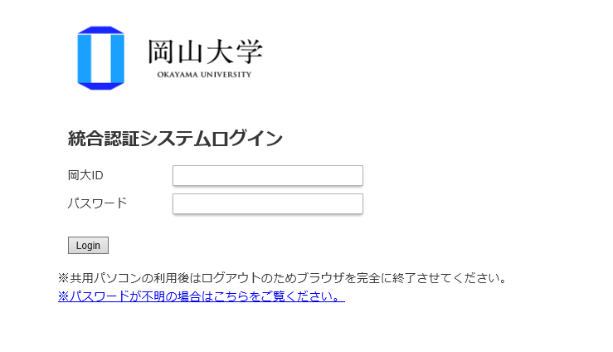
Enter the Okadai ID and Passward.
If you forget your Okadai ID password,
click「パスワードが不明の場合はこちらをご覧ください」.

Slide 4
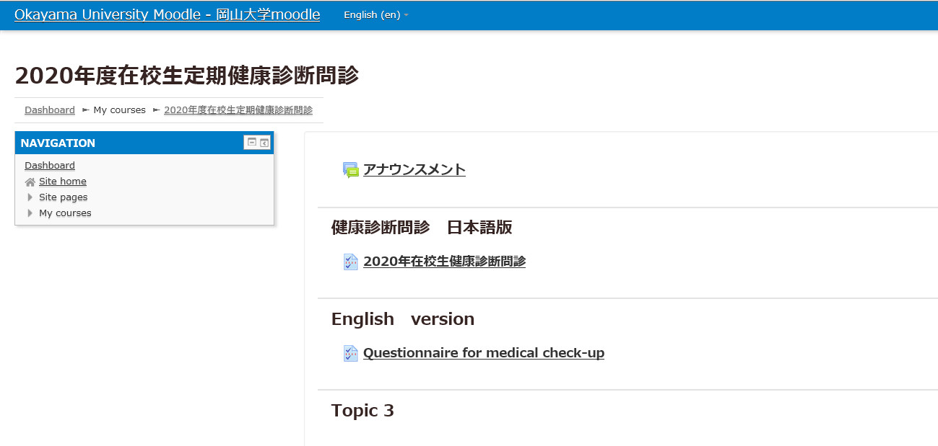
Click
You can answer only once.

Slide 5
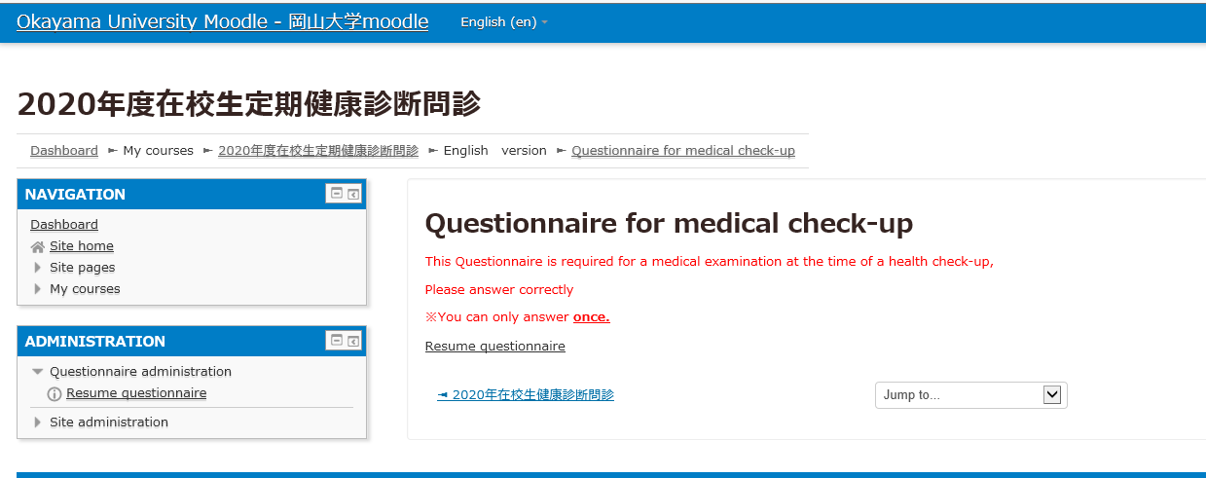
Click

Slide 6
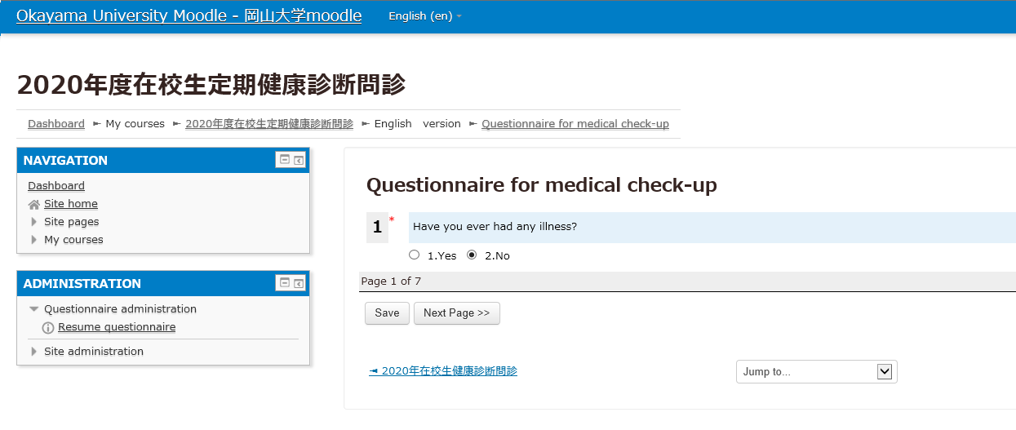
Please choose the item that matches your answer to each question.

Slide 7
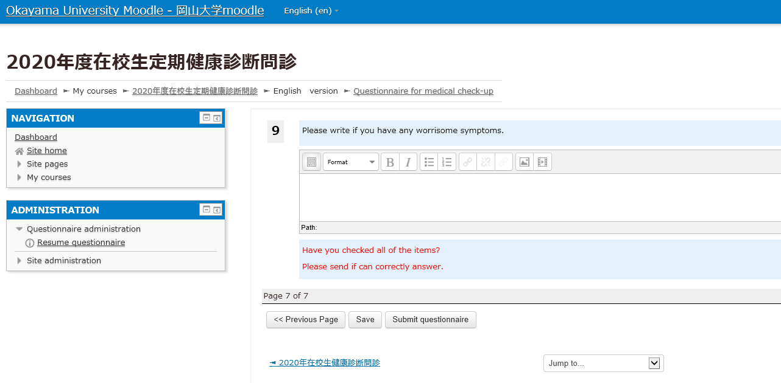
click
Please confirm that you are properly answering.
You are not mistaken, click Submit questionnaire.
Once you send it , you can’t change it.
If you don’t answer all questions, you can’t send it.
You choose save ,you can save answers temporarily.

Slide 8
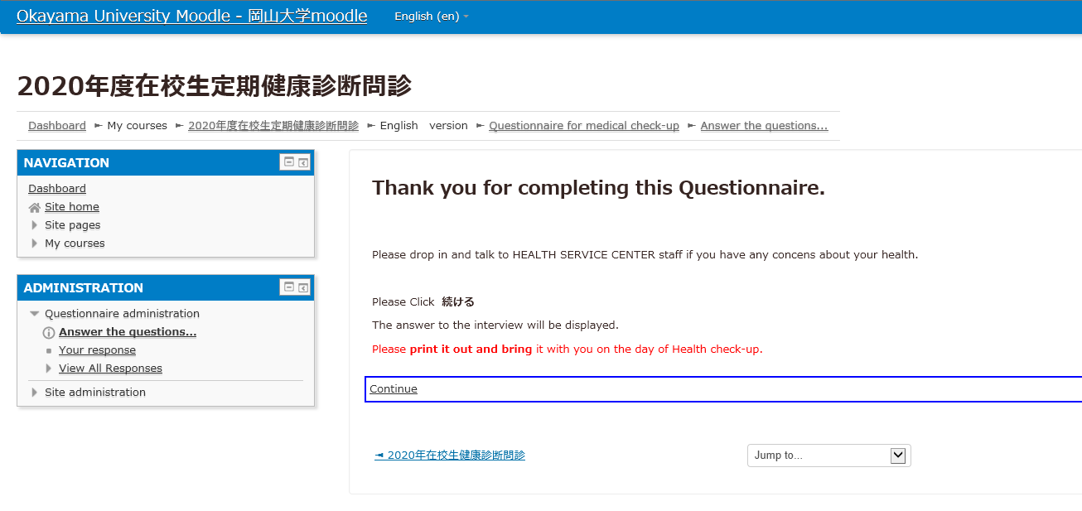
This concludes the answer.
Click Continue, you can read your answers.
But you can’t change your answers.

Slide 9
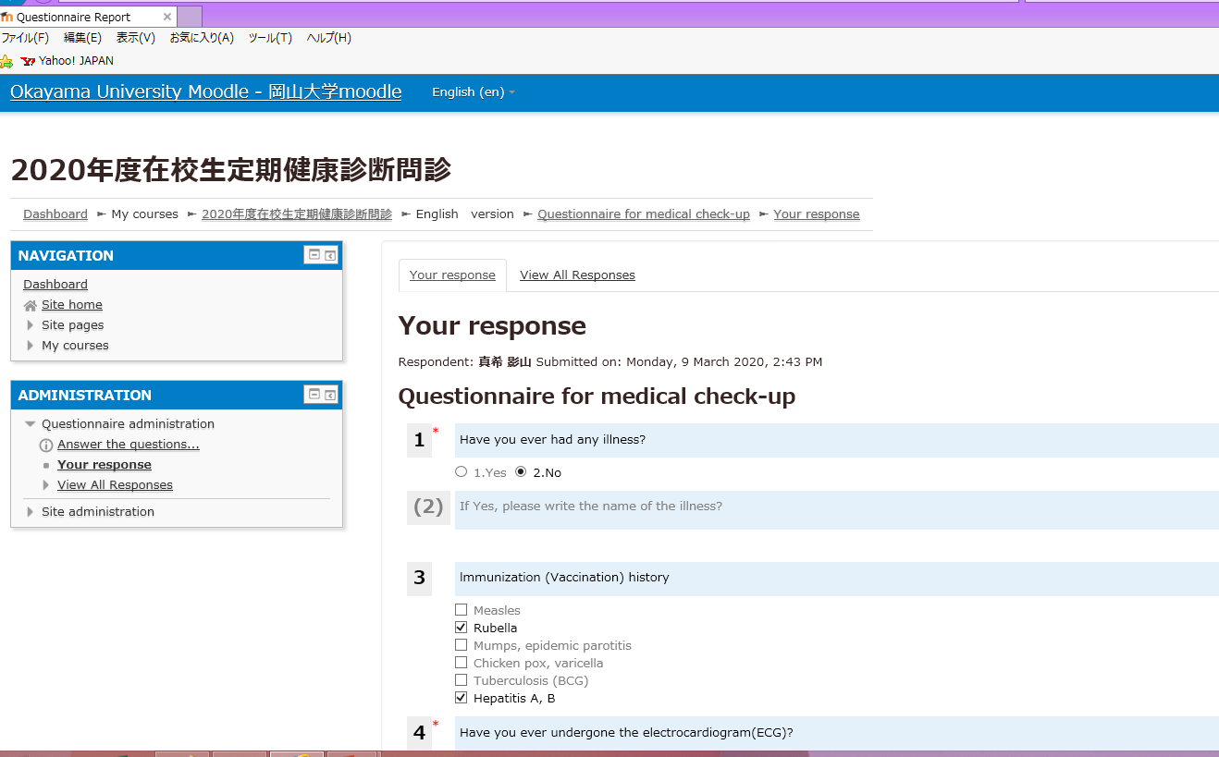
印刷
print
Confirm again.
Please print it out and bring it with you on the day of Health check-up.
Since it’s your personal information, be careful not to lose.

Slide 10
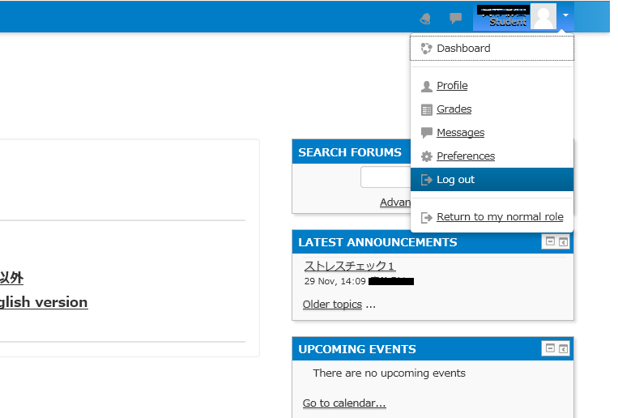
Please log out of the moodle.

